Slide 1
Chapter 3
DATA
Cios / Pedrycz / Swiniarski / Kurgan

Slide 2
Outline
Introduction
Attributes, Data Sets, and Data Storage
Values, Features, and Objects
Data Sets
Data Storage: Databases and Data Warehouses
  Data storage and data mining
Issues Concerning the Amount and Quality of Data
  Dimensionality
  Dynamic aspect of data
  Imprecise, Incomplete, and Redundant data
  Missing values and Noise

Slide 3
Introduction
Data mining/KDP results depend on the quality and quantity of data
  we focus on these issues: data types, data storage techniques, and amount and quality of data
  the above constitutes necessary background for the KDP steps

Slide 4
Attributes, Data Sets and Data Storage
Data have diverse formats and are stored using a variety of storage modes
  a single unit of information is a value of a feature/attribute, where each feature can take on a number of different values
  objects, described by features, are combined to form data sets that are stored as flat files (small data) or other formats in databases and data warehouses

Slide 5
Attributes, Data Sets and Data Storage
values
numerical: 0, 1, 5.34, -10.01
symbolic: Yes, two, Normal, male
features
sex: values ∈{male, female}
blood pressure: values ∈ [0, 250]
chest pain type: values ∈{1, 2, 3, 4}
objects
set of patients
data set (flat file)
objects | features and values
patient 1: male, 117.0, 3
patient 2: female, 130.0, 1
patient 3: female, 102.0, 1
……
database
Denver clinic
data warehouse
three heart clinics
database
San Diego clinic
database
Edmonton clinic

Slide 6
Values, Features and Objects
The key types of values are:
  numerical values are expressed by numbers
    for instance real numbers (-1.09, 123.5), integers (1, 44, 125), prime numbers (1, 3, 5), etc.
  symbolic values usually describe qualitative concepts
    colors (white, red) or sizes (small, medium, big)

Slide 7
Values, Features and Objects
Features described by numerical and symbolic values can be either discrete (categorical) or continuous
  Discrete features concern a situation in which the total number of values is relatively small (finite)
    a special case of a discrete feature is a binary feature with only two distinct values
  Continuous features concern a situation in which the total number of values is very large (infinite) and covers a specific interval/range
  Nominal feature implies that there is no natural ordering between its values, while an ordinal feature implies some ordering
  values for a given feature can be organized as sets, vectors, or arrays

Slide 8
Values, Features and Objects
Objects
(vectors/instances/records/examples/units/cases/
individuals/data points)
represent entities that are described by one or more features
  multivariate data - objects are described by many features
  univariate data - objects are described by a single feature

Slide 9
Values, Features and Objects
Example: patients at a heart disease clinic
  Object “patient” is described by name, sex, age, diagnostic test results such as blood pressure, cholesterol level, and diagnostic evaluation like chest pain type (severity)
name: Konrad Black
sex: male
age: 31
blood pressure: 130.0
cholesterol
in mg/dl: 331.2
chest pain type: 1
patient Konrad Black (object)
symbolic nominal feature
symbolic binary feature {male, female} set
numerical discrete ordinal feature {0, 1, …, 109, 110} set
numerical continuous feature [0, 200] interval
numerical continuous feature [50.0, 600.0] interval
numerical discrete nominal feature {1, 2, 3, 4} set

Slide 10
Data Sets
Objects that are described by the same features form a data set
  many DM tools assume that data sets are organized as flat files, stored in a 2D array comprised of rows and columns, where
    rows represent objects
    columns represent features
  flat files store data in a text file format and are often generated from spreadsheets or databases

Slide 11
Data Sets
Example of patient data
notice new feature type: date (numeric/symbolic)
NULL value indicates that the corresponding feature value is unknown (not measured or missing)
several objects relate to the same patient (Konrad Black, Magda Doe)
for Anna White, the cholesterol value is 45.0, which is outside of the interval defined as acceptable for this feature (so it is incorrect)
Name | Age | Sex | Blood pressure | Blood pressure test date | Cholesterol in mg/dl | Cholesterol test date | Chest pain type | Defect type | Diagnosis
Konrad Black | 31 | male | 130.0 | 05/05/2005 | NULL | NULL | NULL | NULL | NULL
Konrad Black | 31 | male | 130.0 | 05/05/2005 | 331.2 | 05/21/2005 | 1 | normal | absent
Magda Doe | 26 | female | 115.0 | 01/03/2002 | NULL | NULL | 4 | fixed | present
Magda Doe | 26 | female | 115.0 | 01/03/2002 | 407.5 | 06/22/2005 | NULL | NULL | NULL
Anna White | 56 | female | 120.0 | 12/30/1999 | 45.0 | 12/30/1999 | 2 | normal | absent
… | … | … | … | … | … | … | … | … | …

Slide 12
Data Sets
Popular flat file data repositories:
  http://www.ics.uci.edu/~mlearn/ (Machine Learning repository)
  http://kdd.ics.uci.edu/ (Knowledge Discovery in Databases archive)
  http://lib.stat.cmu.edu/ (StatLib repository)
All provide free access to numerous data sets often used for benchmarking purposes
  data are posted with results of their analysis (we posted 3 at UCI)

Slide 13
Data Storage: Databases and Data Warehouses
DM tools can be used on a variety of other than flat files data formats such as
  databases
  data warehouses
  advanced database systems
    object-oriented and object-relational database
    data-specific databases, such as transactional, spatial, temporal, text or multimedia databases
  World Wide Web (WWW)

Slide 14
Data Storage: Databases and Data Warehouses
Why to use database systems?
  Only smaller flat files fit in the memory of a computer
  DM methods must work on many subsets of data and therefore a data management system is required to efficiently retrieve the required pieces of data
  Data are often dynamically added/updated, often by different people in different locations and at different times
  Flat file may include redundant information, which is avoided if data are stored in multiple tables

Slide 15
Data Storage: Databases and Data Warehouses
Data Base Management System (DBMS)
  consists of a database that stores the data and a set of programs for management and fast access
  It provides services like
    ability to define the structure (schema) of the database
    ability to store the data, to access the data concurrently, and have data distributed/stored in different locations
    ensures security (against unauthorized access or system crash)

Slide 16
Databases
The most common DB type is a relational database, which consists of a set of tables
  each table is rectangular and can be perceived as a single flat file
  tables consist of tuples (rows/records) and attributes (columns/fields)
  each table has a unique name and each record is assigned a special attribute (known as a key) that defines unique identifiers
  it includes the Entity-Relational data (ER) model, which defines a set of entities (tables, records, etc.) and their relationships

Slide 17
Databases
Relational database
using multiple
tables results in
removal of redundant
information present
in the flat file
the data are divided
into smaller blocks
that are easier to
manipulate and that fit
into memory
patient
Patient ID | Name | Age | Sex | Chest pain type | Defect type | Diagnosis
P1 | Konrad Black | 31 | male | 1 | normal | absent
P2 | Magda Doe | 26 | female | 4 | fixed | present
P3 | Anna White | 56 | female | 2 | normal | absent
… | … | … | … | … | … | …
blood_pressure_test
Blood pressure test ID | Patient ID | Blood pressure | Blood pressure test date
BPT1 | P1 | 130.0 | 05/05/2005
BPT2 | P2 | 115.0 | 01/03/2002
BPT3 | P3 | 120.0 | 12/30/1999
… | … | … | …
cholesterol_test
Cholesterol test ID | Patient ID | Cholesterol in mg/dl | Cholesterol test date
SCT1 | P1 | 331.2 | 05/21/2005
SCT2 | P2 | 407.5 | 06/22/2005
SCT3 | P3 | 45.0 | 12/30/1999
… | … | … | …
performed_tests
Patient ID | Blood pressure test | Cholesterol test
P1 | BPT1 | SCT1
P2 | BPT2 | SCT2
P3 | BPT3 | SCT3
… | … | …

Slide 18
Databases
DBMS uses a specialized language: SQL (Structured Query Language)
SQL provides fast access to portions of the database
  For example, we may want to extract information about tests performed between specific dates:
    simple with SQL while with a flat file the user must manipulate the data to extract the desired subset of data

Slide 19
Data Warehouses
The main purpose of a DB is data storage, while the main purpose of a data warehouse is data analysis
  data warehouse is organized as a set of subjects of interest
      such as patients, test types or diagnoses
  analysis is done to provide information from a historical perspective
      e.g., we may ask for a breakdown of the most often performed tests over the last five years
    such requests/queries require summarized information
      e.g., a DW may store the number of tests performed by each clinic, during one month, for specific patients age interval

Slide 20
Data Warehouses
Data warehouse for the heart disease clinics
database
Denver heart clinic
clean
transform
integrate
load
(update)
Client A
data warehouse
query
database
San Diego heart clinic
query
database
Edmonton heart clinic
Client B

Slide 21
Data Warehouses
DW usually uses a multidimensional database structure
  each dimension corresponds to an attribute
  each cell (value) in the database corresponds to some summarized (aggregated) measure, e.g., an average
  DW can be implemented as a relational database or a multidimensional data cube
    data cube is a 3D view of the data that allows for a fast access

Slide 22
Data Warehouses
Data cube for the heart disease clinics
  3D: clinic (Denver, San Diego, Edmonton), time (in months), and
  age range (0-8, 9-21, 21-45, 45-65, over 65)
    each dimension can be summarized, e.g., months can be collapsed into quarters
  values in the cells are in thousands and show the number of blood pressure tests performed
TIME
33 27 43 37 18
24 25 35 26 21
there were 8,000 blood pressure tests done in Edmonton clinic in June 2005 for patients over 65 years old
June
May
April
March
February
January
10 17 28 27 8
14 15 28 16 9
11 21 33 12 21
12 32 45 22 14
12 19 48 29 11
9 22 38 9 19
2nd quarter
1st quarter
CLINICS
Denver
San Diego
Edmonton
AGE RANGE
0-8 9-21 21-45 45-65 >65

Slide 23
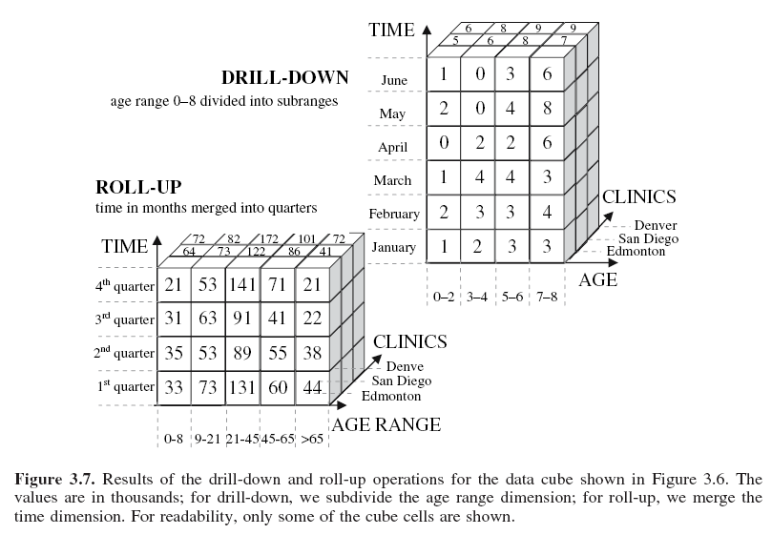

Slide 24
Advanced Data Storage
Relational databases and warehouses are often used by retail stores and banks.
Advanced DBMS satisfy users who need to handle complex data such as:
  transactional
  spatial
  hypertext
  multimedia
  temporal
  WWW content
    They utilize efficient data structures and methods for handling operations on complex data.

Slide 25
Advanced Data Storage
Object-oriented databases are based on the object-oriented programming paradigm, which treats each stored entity as an object
  object encapsulates a set of variables (its description), a set of messages that the object uses to communicate with other objects, and a set of methods that contain code that implements the messages
  similar/same objects are grouped into classes, and are organized in hierarchies
    e.g., the patient class has variables name, address and sex, while its instances are particular patients
      patient class can have a subclass of “retired patients”, which inherits all variables of the patient class but has new variables, e.g., date of home release

Slide 26
Advanced Data Storage
Transactional databases
    a transaction includes unique identifier and a set of items that makes up the transaction
      the difference between relational and transactional database is that the latter stores a set of items, rather than a set of values of the related features
        they are used (by association rules) to identify sets of items that frequently co-exist in transactions
Transation ID | Set of item IDs
TR000001 | Item1, Item32, Item52, Item71
TR000002 | Item2, Item3, Item4, Item57, Item 92, Item93
… | …

Slide 27
Advanced Data Storage
Spatial databases store spatially-related data, such as geographical maps, satellite or medical images
  spatial data can be represented in two formats:
    Raster
    Vector
    Raster format uses n-dimensional pixel map,
    while the Vector format represents all objects as simple geometrical objects, such as lines; vectors are used to compute relations between objects

Slide 28
Advanced Data Storage
Temporal (time-series) databases extend relational databases for handling time-related features
  attributes may be defined using timestamps, such as days and months, or hours and minutes
  time-related features are kept by storing sequences of values that change over time
    in contrast, a relational database stores the most recent values only

Slide 29
Advanced Data Storage
Text databases include features (attributes) that use word descriptions of objects
    sentences or paragraphs of text
      unstructured - written in plain language (English, Polish, Spanish, etc.)
      semistructured - some words or parts of the sentence are annotated (like drug’s name and dose)
      structured where all the words are annotated (physician’s diagnosis may use a fixed format to list specific drugs and doses)
    they require special tools and integration with text data hierarchies, such as dictionaries, thesauruses, and specialized term-classification systems (such as those used in medicine)

Slide 30
Advanced Data Storage
Multimedia databases allow storage, retrieval and manipulation of image, video, and audio data
  the main concern here is their very large size
    video and audio data are recorded in real-time, and thus the database must include mechanisms that assure a steady and predefined rate of acquisition to avoid gaps, system buffer overflows, etc.

Slide 31
Advanced Data Storage
WWW is an enormous distributed repository of data linked together via hyperlinks
    hyperlinks link individual data objects of different types together allowing for an interactive access
    most specific characteristic of the Web is that the users seek information by traversing between objects via links
    WWW uses specialized query engines such as Google and Yahoo!

Slide 32
Advanced Data Storage
Heterogeneous databases consist of a set of interconnected databases that communicate between themselves to exchange the data and provide answers to user queries
    the biggest challenge is that the objects in the component databases may differ substantially, which makes it difficult to develop common semantics to facilitate communication between them

Slide 33
Data Storage and Data Mining
Data Mining vs. Utilization of a Data Storage
  DW and DB users often understand data mining as an execution of a set of the OLAP commands
    BUT data/information retrieval should not be confused with data mining
  DM provides more complex techniques for understanding data and generating new knowledge
    DM allows for semi-automated discovery of patterns/trends
      e.g., learning that increased blood pressure over a period of time leads to heart defects

Slide 34
Issues of the Amount and Quality of Data
Several issues related to data have significant impact on the quality of KDP outcome:
  huge and highly-dimensional volume of data, and problem of DM methods scalability
  dynamic nature of data – data are constantly being updated/changed
  problems related to data quality, such as imprecision, incompleteness, noise, missing values, and redundancy

Slide 35
High Dimensionality
Among many DM tools available only few are “truly” able to mine high-dimensional data
Handling massive amount of data requires algorithms to be scalable
Note that scalability is not related to efficient storage and retrieval (these belong to DBMS) but to the algorithm design
  machine learning and statistical data analysis systems are only partially capable of handling massive quantities of data

Slide 36
High Dimensionality
Is it a real problem?
  Analysis of data from large retail stores goes into hundreds of millions of objects per day, while bioinformatics data are described by thousands of features (e.g., microarray data)
  Large commercial databases now average about one PB of objects

Slide 37
High Dimensionality
There are three “dimensions” of high-dimensionality data:
  The number of objects, which may range from a few hundred to a few billion
  The number of features, which may range from a few to thousands
  The number of values a feature assumes, which may range from 1-2 to millions

Slide 38
High Dimensionality
The ability of a particular DM algorithm to cope with highly dimensional data is described by its asymptotic complexity
  it estimates the total number of operations, which translates into the specific amount of run time
  it describes the growth rate of the algorithm’s run time as the size of each dimension increases
  the most commonly used complexity analysis describes scalability with respect to the number of objects

Slide 39
High Dimensionality
To illustrate:
Assume the user wants to generate knowledge in terms of production IF…THEN… rules using either a decision tree or a rule algorithm:
  Proprietary See5 alg. has log-linear complexity, i.e., O(n*log(n)), where n is the number of objects
  DataSqueezer alg. also has log-linear complexity
  CLIP4 alg. has quadratic complexity, i.e., O(n²)
  C4.5 rules (early version of See5) alg. has cubic complexity, i.e. ,O(n³)

Slide 40
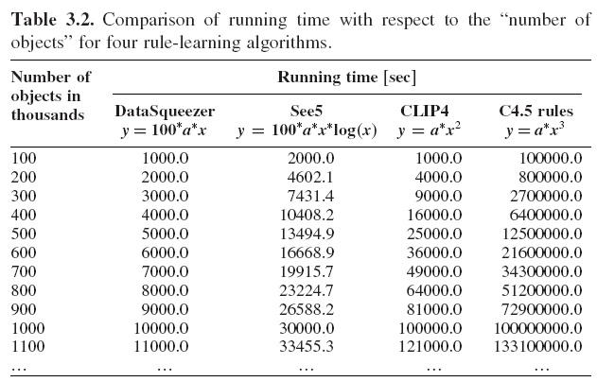

Slide 41
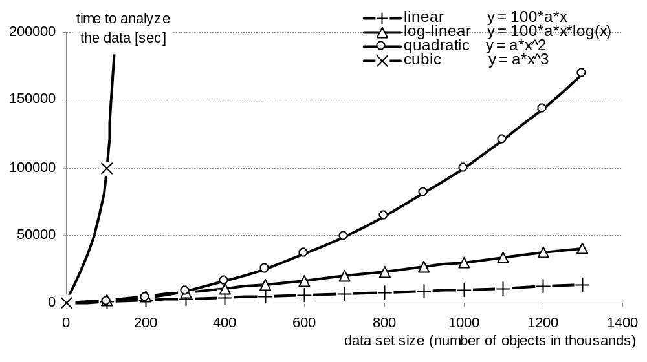
High Dimensionality
This example illustrates the importance of asymptotic complexity
for 100 objects the linear algorithm computes the results in 1,000 seconds, while the cubic algorithm in 100,000 seconds (using previous formulas)
when the number of objects increases 10x (to 1000) the time to compute the results for the linear algorithm increases to 10,000 seconds, and to 100,000,000 seconds for the cubic algorithm

Slide 42
High Dimensionality
Two techniques are used to improve scalability:
  speeding up the algorithm
    achieved through the use of heuristics, optimization, and parallelization
      Heuristics: generate only rules of a certain maximal length
      Optimization: use efficient data structures such as bit vectors, hash tables, or binary search trees to store and manipulate the data
      Parallelization: distribute processing of the data into several processors

Slide 43
High Dimensionality
Two techniques can be used to improve scalability:
partitioning of the data set
  (a) reduce dimensionality of the data and (b) use sequential or parallel processing of subsets of data
    in dimensionality reduction the data is sampled and only a subset of objects and/or features is used
      Sometimes it is necessary to reduce the complexity of features by discretization
    division of data into subsets is used when an algorithm’s complexity is worse than linear

Slide 44
Dynamic Data
Data are often dynamic
as new objects and/or
features may be added,
and/or objects and
features may be
removed or changed
DM algorithms
should evolve
with time, i.e.,
the knowledge
derived so far
should be
incrementally
updated
Knowledge generated from the initial data
Data set
Data mining algorithm
Knowledge
Non-incremental data mining
New knowledge is generated from scratch from the entire new data set
Incremental data mining
New knowledge is generated from new data and the existing knowledge
Knowledge
Knowledge
data set
data set
New Knowledge
Data mining algorithm
new data
new data
Data mining algorithm
New Knowledge

Slide 45
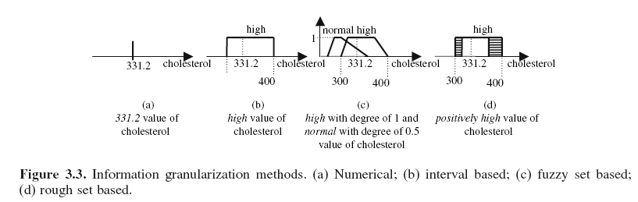
Imprecise Data
Data often include imprecise objects
  e.g., we may not know the exact value of a test, but know whether the value is high, average, or low
  in such cases fuzzy and/or rough sets can be used to process such information: INFORMATION GRANULARITY

Slide 46
Incomplete Data
Def.: Data that does not contain enough information to discover (potentially) new knowledge.
  e.g., when analyzing heart patients data if one wants to distinguish between sick and healthy patients
  but only demographic information is given it is impossible to do so

Slide 47
Incomplete Data
  In case of incomplete data we first need to identify the fact and take some corrective measures.
    to detect incompleteness the user must analyze the existing data and assess whether the features and objects give sufficiently rich representation of the problem
      if not we must collect additional data (new features and/or new objects)

Slide 48
Redundant Data
Def.: Data containing two or more identical objects, or when features are strongly correlated.
  redundant data are often removed, but sometimes the redundant data contains useful information, e.g., frequency of the same objects provides useful information about the domain
  a special case is irrelevant data, where some objects and/or features are insignificant with respect to data analysis
    e.g., we can expect that patient’s name is irrelevant with respect to heart condition
  redundant data are identified by feature selection and feature extraction algorithms and removed

Slide 49
Missing Values
Many data sets are plagued by the problem of missing values
  missing values can be a result of errors in manual data entry, incorrect measurements, equipment errors, etc.
  they are usually denoted by special characters such as:
  NULL
  *
  ?

Slide 50
Missing Values
Are handled in two basic ways:
  removal of missing data
    the objects and/or features with missing values are discarded: can be done only when the removed objects features are not crucial for analysis (e.g., in case of a huge data set)
    practical only when the data contain small proportion of missing values
      e.g., when distinguishing between sick and healthy heart patients, removing blood pressure feature will result in biasing the discovered knowledge towards other features, although it is known that blood pressure is important

Slide 51
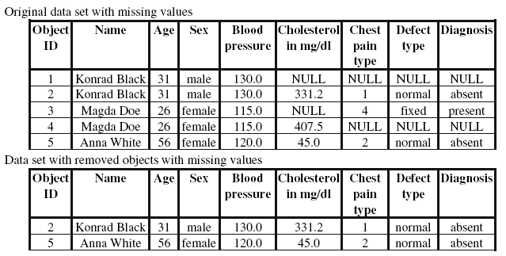

Slide 52
Missing Values
Are handled in two basic ways:
imputation (filling-in) of missing data
  performed using
    single imputation methods, where a missing value is imputed by a single value
    multiple imputations methods, where several likelihood-ordered choices for imputing the missing value are computed and one “best” value is selected

Slide 53
Missing Values
Single imputation
  mean imputation method uses mean of the values of a feature that contains missing data
    in case of a symbolic/categorical feature, a mode (the most frequent value) is used
    the algorithm imputes missing values for each attribute separately, and can be conditional or unconditional
      the conditional mean method imputes a mean value that depends on the values of the complete features for the incomplete object

Slide 54
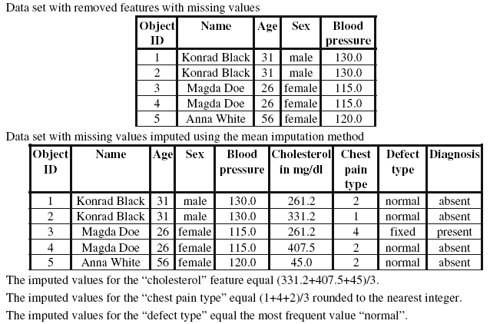

Slide 55
Missing Values
Single imputation
  hot deck imputation: for each object that contains missing values the most similar object is found
  (according to some distance function), and the missing values are imputed from that object
    if the most similar record also contains missing values for the same feature then it is discarded and another closest object is found
      the procedure is repeated until all of the missing values are imputed
      when no similar object is found, the closest object with the minimum number of missing values is chosen to impute the missing values

Slide 56
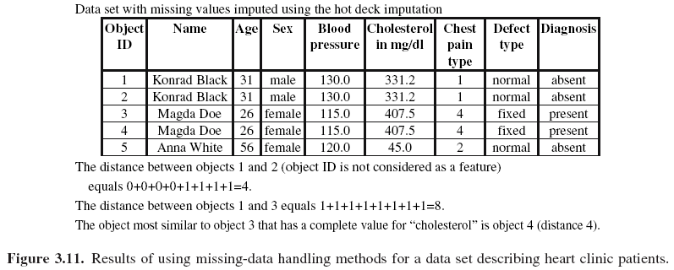

Slide 57
Noise
Def.: Noise in the data is defined as a value that is a random error, or variance, in a measured feature
  the amount of noise in the data can jeopardize KDP results
  the influence of noise on data can be prevented by imposing constraints on feature values to detect anomalies
    e.g., DBMS has a facility to define constrains for individual attributes

Slide 58
Noise
Noise can be removed using
  Manual inspection using predefined constrains on feature values
    and manually removing (or changing into missing values) all values that do not satisfy them
  Binning
    Requires ordering values of the noisy feature and then substituting the values with a mean or median value for predefined bins
  Clustering
    It finds groups of similar objects and simply removes (or changes into missing values) all values that fall outside of clusters

Slide 59
Noise
Noise removal using clustering
cholesterol
400
300
200
100
0
cluster
potential outlier (noise)
20 30 40 50 60 70
age

Slide 60
References
Holsheimer, M. and Siebes, A. 1994. Data Mining: The Search for Knowledge in Databases, Report CS-R9406, ISSN 0169-118X, CWI: Dutch National Research Center, Amersterdam, Netherlands
Ganti, V., Gehrke, J. and Ramakrishnan, R. Aug. 1999. Mining Very Large Databases, IEEE Computer, 32(8):38-45
Klosgen, W. and Zytkow, J. (Eds) 2002. Handbook of Data Mining and Knowledge Discovery, Oxford University Press
Shafer, J.L. 1997. Analysis of Incomplete Multivariate Data, Chapman and Hall

